Slide 1
CS 31006: Computer Networks – Transport Layer Services

Slide 2
Protocol Stack Implementation in a Host
Application
Software, Kernel
Transport
Network
Data Link
Firmware, Device Driver
Physical
Hardware

Slide 3
How Application Data Passes Through Different Layers
Application
HTTP Header
HTTP Data
Transport
TCP Header
Transport Layer Data
Network
IP Header
Network Layer Data
Data Link
MAC Header
Data Link Layer Data
Physical
PHY Header
MAC Header
IP Header
TCP Header
HTTP Header
HTTP Data
PHY Trailer

Slide 4
Transport Layer Services
UDP
TCP
End to end packet delivery
Connection Establishment
Reliable Data Delivery
Flow and Congestion Control
Ordered Packet Delivery
Transport
Datagram delivery (unreliable)
Network
Data Link

Slide 5
Connection Establishment
CONNECT
Connection establishment : A Connection is akin to a logical pipe using which the Client and the Server ( or any two end systems can transfer data among each other)
Client
Server
CONNECTION REQ
LISTEN
CONNECTION ACK
2 – Way Hand Shaking
This is a simple primitive for connection establishment – but does this work good?

Slide 6
Connection Establishment
Consider a scenario when the network can lose, delay, corrupt and duplicate packets (the underline network layer uses unreliable data delivery)
So the packet switching paradigm of frame transfer which is followed renders a possibility of packet loss due to a inflow-outflow rate exceeding the buffer size capacity at a particular router. Hence it is not so trivial to ensure whether or not your data packet has reached the destination or not, and if it has decoded it or not. So lets say that a packet kind of encountered some problem has not reached the end system, and hence no acknowledgement has been issued. While waiting for this acknowledgement, we might encounter a TIMEOUT and infer that the packet is LOST. Now since this is a reliable connection, another connection request will be sent . Now all the packets take absolutely different paths and hence they can reach not in an absolute FIFO manner. So the newer packets might even reach the end system before the older ones and render a confusion as to whether they are a new connection request or the same requests’ duplicate.
Consider retransmission for ensuring reliability – every packet uses different paths to reach the destination
Packets may be delayed and got struck in the network congestion, after the timeout, the sender assumes that the packets have been dropped, and retransmits the packets

Slide 7
Connection Establishment
It may happen that the client has crashed and reinitiated the connection . So distinguishing between these two is essential .
REQ1 is the first Request
then CRASH and then
REQ2 happened. Effectively REQ2 serves the purpose of REQ1.
Client
Server
CONNECT
CONNECTION REQ - 1
LISTEN
CONNECTION REQ - 2
How will the server differentiate whether CONNECTION REQ-1 is a new connection request or a duplicate of the CONNECTION REQ-2 which it received first ?

Slide 8
Connection Establishment
Protocol correctness versus Protocol performance – an eternal debate in computer networks …
Delayed duplicates create a huge confusion in the packet switching network. A major challenge in packet switching network is to develop correct or at least acceptable protocols for handling delayed duplicates.
So in order to ensure CORRECTNESS, some added modules need to be implemented which check whether or not some incoming connection is a duplicate or not. This may work however, it is at the cost of the performance/efficiency of the protocol since this computation and checking using the additional modules is basically an CONNECTION ESTABLISHMENT OVERHEAD, since we are not actually transferring any data here but just spending computational time in order to ESTABLISH A CONNECTION.
Hence it is a tradeoff between correctness and performance. However even if we prefer performance as the driving factor, we need to ensure a certain degree of correctness in the implementation being adopted.

Slide 9
Connection Establishment – Handling Delayed Duplicates
Solution 1: Use Throwaway Transport Address (Port Numbers)
Do not use a port number if it has been used once already – Delayed duplicate packets will never find their way to a transport process
Is this solution feasible?
So what can be done is that each application ka each connection will be like assigned to a particular port and after that this port will NOT be used, perhaps for a TIMEOUT amount of time. So if another request arrives with the same PORT NO. in its header per-se, that would mean it is a delayed duplicate and be rejected. The Solution is not FEASIBLE since we might not have that many ports ki we can do something like a use and throw of ports and still cater to all the connection requests of the APPLICATION LAYER.
Solution 2: Give each connection a unique identifier chosen by the initiating party and put in each segment
Can you see any problem in this approach?
Each time we need to make sure that we create a UNIQUE identifier and ALSO that this identifier is globally unique.
The main implementation level problem in this is that there has to be some hardware construct such that even if a system crash occurs the subsequent identifiers which are created are not clashing in any sense with the identifiers which were created before the system crash occurred. HENCE this implementation can be implemented using the hardware triggers and stuff, has a decent amount of overhead which again is not really feasible.

Slide 10
Connection Establishment – Handling Delayed Duplicates
Soln 3: Devise a mechanism to kill off aged packets that are still hobbling about (Restrict the packet lifetime) – Makes it possible to design a feasible solution
Three ways to restrict packet lifetime
Restricted Network Design – Prevents packets from looping (bound the maximum delay including congestion)
Putting a hop count in each packet – initialize to a maximum value and decrement each time the packet traverses a single hop (most feasible implementation)
Timestamping each packet – define the lifetime of a packet in the network => this needs time synchronization across each router, in each system on the network; which is not possible since the hardware clocks of any two systems will definitely be a little different from each other, one of the unsolvable challenges in COMPUTER ARCHITECTURE
Design Challenge: We need to guarantee not only that a packet is dead, but also that all acknowledgements to it are also dead

Slide 11
Connection Establishment – Handling Delayed Duplicates
Let us define a maximum packet lifetime T – If we wait a time T secs after a packet has been sent, we can be sure that all traces of it (packet and its acknowledgement) are now gone
Rather than a physical clock (clock synchronization in the Internet is difficult to achieve), let us use a virtual clock – sequence number generated based on the clock ticks
Label segments with sequence numbers that will not be reused within T secs.
The period T and the rate of packets per second determine the size of the sequence number – at most one packet with a given sequence number may be outstanding at any given time in the network
So basically the way we are ensuring that we do not receive duplicates is -> We first assign a Lifetime T to each Packet in the sense that after T time all the instances of that packet , itself or its acknowledgement roaming around in the network is rendered dead/irrelevant. How to do this ?
So what we do is while generating packets, we use certain UNIQUE SEQUENCE NUMBERS to label the segments being sent. We ensure that in any interval of T time, there is at most one packet with a given sequence number -> these sequence numbers can be thought to be the unique identifier of these packets. So a certain systematic routine will be followed in such a way that the Sequence number which we are expecting out of the packet will be known before hand even to the Receiving Side. So since the receiving sides already knows the sequence number of the intended packet, and we ensure that there is only one packet of a given sequence number during its lifetime, we more or less rule out the possibilities of a duplicate reaching the receiver.

Slide 12
Sequence Number Adjustment
Two important requirements (Tomlinson 1975, Selecting Sequence Numbers)
Sequence numbers must be chosen such that a particular sequence number never refers to more than one byte (for byte sequence numbers) at any one time (how to choose the initial sequence number? )
The valid range of sequence numbers must be positively synchronized between the sender and the receiver, whenever a connection is used (three way handshaking followed by the flow control mechanism – once connection is established, only send the data with expected sequence numbers)
So basically something like this that, ( SEE SC ka NPTEL wala Lecture Transcript ka page 19 )
The headache is to choose the INITIAL SEQUENCE NUMBER, because the Flow Control Algorithms etc kind of determine what the subsequent initial numbers are going to be. The sequence numbering we follow is byte by byte implying each byte being sent out in the network will have a unique sequence number to identify it, so each packet is like an array with the packet header = array name, base address and the number of the byte from the start will add to the base address to give the unique sequence number for that particular byte. We need to maintain standard protocol while doing this because on both sides the sequence numbers : generated and expected ; should be synchronized with each other else the intended packet number != received/generated packet number => FALSE ERROR.

Slide 13
Why Initial Sequence Number is Important
Conn 2 initialized
The sequence numbers increase with time at a rate equal to the rate of packet//byte generation. The faster the data//packets are being generated, the more rapid the increase in the Sequence Numbers shall be.
Conn 1 crashed
Connection 2
Sequence Numbers
Connection 1
Time
Packet Lifetime T
A Delayed duplicate packet of connection 1 can create a confusion for connection 2
What’s the notion of a delayed duplicate in this Sequence Number wala paradigm ?
I guess duplicates are generated in case the first time packet which was sent was not acknowledged back by the receiver. In that case since we have to send the same packet again we SHALL use the same sequence number et al because they are affectively the same data packet. TWO DIFFERENT PACKETS should NEVER HAVE THE SAME SEQUENCE NUMBER in the network within their intersecting lifetimes.

Slide 14
What We Ideally Want? Or …
Handling the case of NO CLASH on Sequence Numbers by shifting the new connection on the TIME SCALE which ensures that the sequence number I use now have already died out from the previous Connection.
Conn 2 initialized
Conn 1 crashed
Sequence Numbers
Connection 2
Connection 1
Time
Packet Lifetime T

Slide 15
What We Ideally Want? Either …
Handling the case of NO CLASH on Sequence Numbers by shifting the new connection on the SEQUENCE NUMBER SCALE which ensures that the sequence number I use now was not even used in the previous Connection.
Conn 2 initialized
Connection 2
Conn 1 crashed
Sequence Numbers
Connection 1
Time
Packet Lifetime T

Slide 16
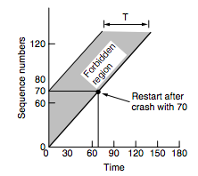
Connection Establishment – Handling Delayed Duplicates
If a receiver receives two segments having the same sequence number within a duration T, then : - one packet must be the duplicate. The receiver then discards the duplicate packets.
For a crashed device, the transport entity remains idle for a duration T after recovery, to ensure that all packets from the previous connection are dead – not a good solution
Adjust the initial sequence numbers properly - A host does not restart with a sequence number in the forbidden region, based on the sequence number it used before crash and the time duration T.

Slide 17
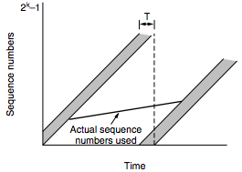
How do We Ensure that Packet Sequence Numbers are Out of the Forbidden Region
Two possible source of problems
A host sends too much data too fast on a newly opened connection
In this case, what might happen is that, since the rate is so high, the ascend of sequence numbers in the second case is so rapid that even though the START was ok, but the used up sequence numbers in the new connection have now merged with the lifetime of the previous ones.
The data rate is too slow that the sequence number for a previous connection enters the forbidden region for the next connection
In this case the problem is similar in the sense that the slow ascend of this Connection may get caught up by the relatively faster ascend of the next connection and hence again an overlap of lifetimes of packets with same sequence numbers might occur.
Source: Computer Networks (5th Edition) by Tanenbaum, Wetherell

Slide 18
Adjusting the Sending Rate based on Sequence Numbers
The maximum data rate on any connection is one segment per clock tick
Clock ticks (inter-packet transmission duration) is adjusted based on the sequences acknowledged (I guess feedback of network, RTT etc ) – ensure that no two packets are there in the network with same sequence number
We call this mechanism as self-clocking (used in TCP)
Ensures that the sequence numbers do not warp around too quickly (RFC 1323)
This is basically a way to regulate the rate at which the packets are transmitted and hence the rate at which sequence numbers are generated.
We do not remember sequence number at the receiver: Use a three way handshake to ensure that the connection request is not a repetition of an old connection request
The individual peers validate their own sequence number by looking at the (ACK)
Positive synchronization among the sender and the receiver

Slide 19
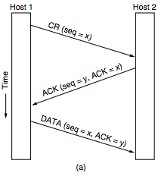
Three Way Handshake
By looking at the ACK, Host 1 is assured that Sequence number x does not belong to the forbidden region of any previously established connection
X -> Forward Connection ka SEQ_NUM
By looking at the ACK in DATA, Host 2 is assured that sequence number y does not belong to the forbidden region of any previously established connection
Y -> Backward Connection ka SEQ_NUM
Computer Networks (5th Edition) by Tanenbaum

Slide 20
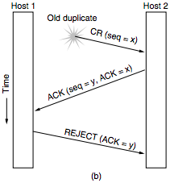
Three Way Handshake – CONNECTION REQUEST is a Delayed Duplicate
So basically what can be thought of happening in this situation is that let us say that the HOST1 initially had sent a Connection Request to HOST2, but then crashed and had to be RESTARTED.
The HOST2 nonetheless receives that connection request, validates it and sends out the ACK along with the backward connection ka SEQ_NUM.
The HOST1 receives an ACK which it was not expecting/accepting, since it is no longer accepting connections at that previous SEQ_NUM, hence it sends back a simple REJECT message which when received by the HOST2 also makes it drop the connection.
Computer Networks (5th Edition) by Tanenbaum,

Slide 21
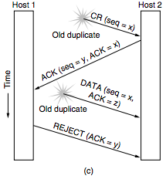
CONNECTION REQUEST and ACK both are Delayed Duplicates
So basically what can be thought of happening in this situation is that let us say that the HOST1 initially had sent a Connection Request to HOST2, but then crashed and had to be RESTARTED.
The HOST2 nonetheless receives that connection request, validates it and sends out the ACK along with the backward connection ka SEQ_NUM.
The HOST1 receives an ACK which it was not accepting, since it is no longer accepting connections at that previous SEQ_NUM, hence it sends back a simple REJECT message which when received by the HOST2 also makes it drop the connection.
Before that perhaps there was another similar connection request made and the HOST is sending DATA with the same SEQ_NUM but a different ACK. In this case the HOST2 realizes that the ACK it has received is not the one it was expecting and hence rejects that DATA Packet from the HOST1.
It further then detects the REJECT message for the corresponding ACK value and then closes the connection.
Source: Computer Networks (5th Edition) by Tanenbaum, Wetherell

Slide 22
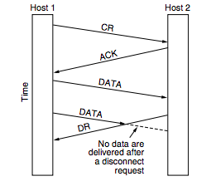
Connection Release – Asymmetric Release
When one party hangs up, the connection is broken
This may results in data loss
Source: Computer Networks (5th Edition) by Tanenbaum, Wetherell

Slide 23
Connection Release – Symmetric Release
Treats the connection as two separate unidirectional connections and requires each one to be released separately
Does the job when each process has a fixed amount of data to send and clearly knows when it has sent it.
What can be a protocol for this?
Host 1: “I am done”
Host 2: ”I am done too”
Does this protocol work good always?

Slide 24
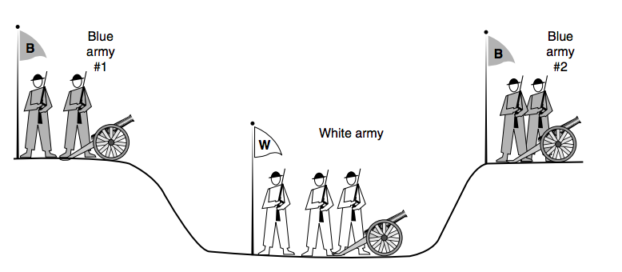
The Two Army Problem
Source: Computer Networks (5th Edition) by Tanenbaum, Wetherell
Let every party take independent decisions
No protocol exists to solve this

Slide 25
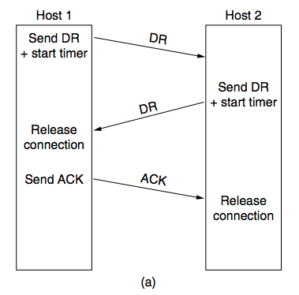
Connection Release – Symmetric Release
Source: Computer Networks (5th Edition) by Tanenbaum, Wetherell

Slide 26
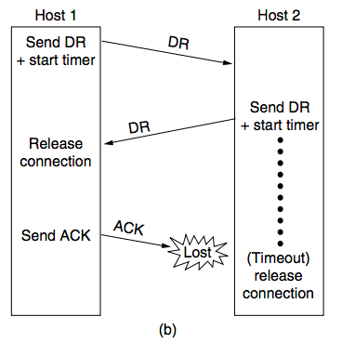
Connection Release – Symmetric Release –> Final ACK Lost
Host1 Initiates a Connection Release, by
Sending a DATA RELEASE and Starts a TIMER, awaiting an ACK from Host2.
Host2 Receives the DR and Sends back another DR which acts as an ACK for the initially sent DR by the HOST1 and also informs about Host2 being ready to relinquish the connection, that it does not have any problem in release of connection The Host1 receives the ACK//DR
ACK -> Releases the Connection
DR -> Sends Host2 an ACK
The Host2 received the ACK -> Releases Connection
If ACK Lost, it TIMES OUT and Releases Connection
Source: Computer Networks (5th Edition) by Tanenbaum, Wetherell

Slide 27
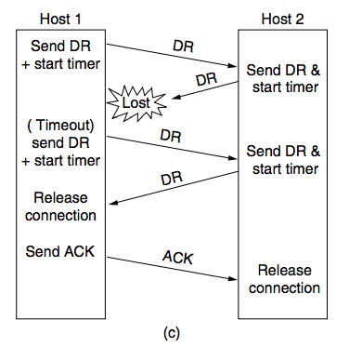
Connection Release – Symmetric Release –> Response Lost
Host1 Initiates a Connection Release, by
Sending a DATA RELEASE and Starts a TIMER, awaiting an ACK from Host2.
Host2 Receives the DR and Sends back another DR which acts as an ACK for the initially sent DR by the HOST1 and also informs about Host2 being ready to relinquish the connection.
The DR/ACK gets LOST
The Host1 suffers a timeout and resends the DR
Source: Computer Networks (5th Edition) by Tanenbaum, Wetherell

Slide 28
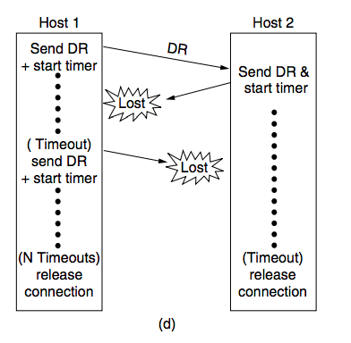
Connection Release – Response Lost and Subsequent DRs Lost
The DR/ACK gets LOST
The Host1 suffers a timeout and resends the DR
This DR also gets LOST
The Host2 is waiting for an ACK of its sent DR
The Host1 is waiting for an ACK of its resent DR , wont receive it since it is LOST
Suffers Timeout and resends the DR
The Host2 is still in waiting for an ACK
After a N number of successive timeouts, both the hosts release the connection.
Source: Computer Networks (5th Edition) by Tanenbaum, Wetherell

Slide 29
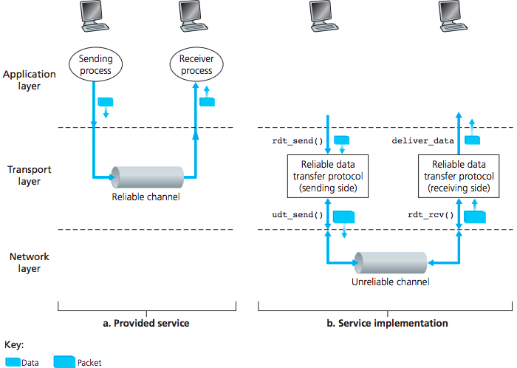
Ensure Reliability at the Transport Layer
Source: Computer Networks, Kurose, Ross

Slide 30
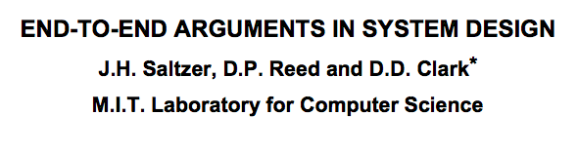
Error Control and Flow Control
These features are used in both Data Link Layer and Transport Layer – Why?
Flow control and error control at the transport layer is essential Flow control at the Transport Layer is applied in an End to End Sense, and has information about the Route which the Packet shall take and the Congestion/capacity of the links on that route. So locally even though a certain link can transmit at a high speed, there might be another part of the route which is the rate determiner. If the transmit link from any hub is greater than this, than queuing delay shall occur and this may lead to packet loss if the buffer gets full. Hence an overview of the whole route which the transport layer has is important to decide the optimum value of the flow.
Flow control and error control at the data link layer improves performance So locally at each HUB, if we have a control of flow in such a way that it allows only that much of INFLOW into the Hub through the links that it can FLOW-OUT, then the queuing delays will be reduced and all the incoming packets will be transferred relatively fast.
So basically what happens is, the END to END will determine what is the OPTIMAL SPEED at which the packet transmission should occur in order to ensure that there is no PACKET LOSS due to Buffers OVERFLOWING. Now the HUBS and the links on this ROUTE might be a part of some other ROUTES as well and the traffic on them might lead to Queuing Delays at the HUB level. The HUB to HUB here will determine what amount of data packets are to be taken from the multiple Links in flowing data into the HUB so that all the packets are dispatched relatively fast without much delay or loss.

Slide 31
Flow Control Algorithms
Stop and Wait Flow Control (Error Free Channel):
This is an idealistic scenario for when the channel is error-free, and the chances of frame loss are next to nil.

Slide 32
Flow Control Algorithms
Stop and Wait (Noisy Channel):
Use sequence numbers to individually identify each frame and the corresponding acknowledgement
What can be a maximum size of the sequence number in Stop and Wait?
Since we wait for the previous packets’ acknowledgement before sending another packet, at most we have two different classes of packets. Hence a 0/1 would suffice?
Automatic Repeat Request (ARQ)
But sends out an ACK again

Slide 33
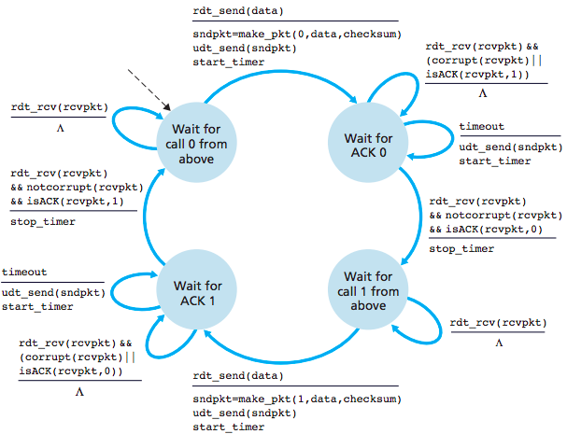
Stop and Wait ARQ – Sender Implementation
What is the need for even two bits ?
This happens to be useful in the case when the Acknowledgment from the Receiver gets lost or does not reach before the timeout occurs.
So the sender side on not receiving the Acknowledgment, sends out the packet again.
Now when the Receiver receives the packet again, it finds out that it has already received and processed this packet, so it does not need to process it again and simply discards it. However it understands the reason as to why it has received a duplicate frame and sends back the corresponding required Acknowledgment again in a hope that this time it reached the Sender.
Above -> App Layer
Above -> App Layer
Computer Networks Kurose, Ross

Slide 34
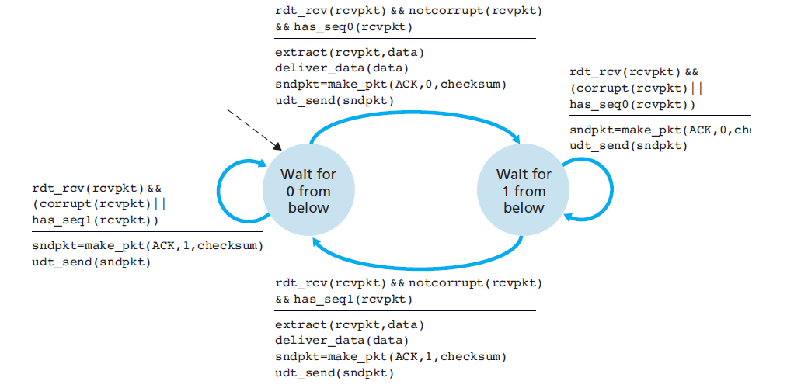
Stop and Wait ARQ – Receiver Implementation

Slide 35
Problem with Stop and Wait
Every packet needs to wait for the acknowledgement of the previous packet. Considerable amount of time loss occurs, sequential process hence we cannot send data in a parallel fashion
For bidirectional connections – use two instances of the stop and wait protocol at both directions – further waste of resources The same problems simply get enhanced in this way because a further wastage of time and resources occurs due to the need to wait at both sides for an ACK before proceeding with the transfer of data at each step.
A possible solution: Piggyback data and ACK from both the directions. The ACK by one side is Appended with the Data to be sent by that side so that it reduces a fair amount of stop and waits. This probably works because when we send an ACK we know that the receiver is waiting for it, so might as well send the data as well along with it.
Reduce resource waste based on sliding window protocols (a pipelined protocol)
Pipelining would enable parallel sending of data packets without needing to wait out the ACK for the previously sent packets.

Slide 36
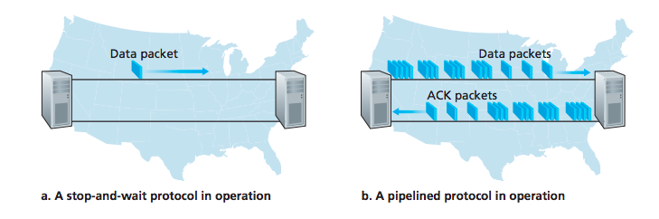
Stop and Wait versus Sliding Window (Pipelined)
Source: Computer Networks, Kurose, Ross

Slide 37
Sliding Window Protocols
Each outbound segment contains a sequence number – from 0 to some maximum (2^{n}-1 for a n bit sequence number)
The sender maintains a set of sequence numbers corresponding to frames it is permitted to send without having to bother about receiving any ACK (Sending Window)
The receiver maintains a set of sequence numbers corresponding to frames it is permitted to accept without having to bother about sending any ACK (Receiving Window)

Slide 38
Sliding Window Protocols – Sending Window and Receiving Window
Here, the green marked sequence numbers are those which are outstanding and whose ACKs are yet to be received. As soon as am ACK is received for one of them we SLIDE OUR WINDOW FORWARD to take that SEQNUM out of out WINDOW of Outstandings
An alternate way of implementation uses Cumulative ACK as well, where if we receive an ACK for N , all the outstanding frames in the Window with a SeqNum <= N are relieved and the window slides by N-Base+1 places
Here again, green marked sequence numbers are those which have been received but their ACKs have not been sent out yet. As soon as their ACK are sent out, we SLIDE our window to get ready to accept more frames.
Source: http://ironbark.xtelco.com.au/subjects/DC/lectures/13/

Slide 39
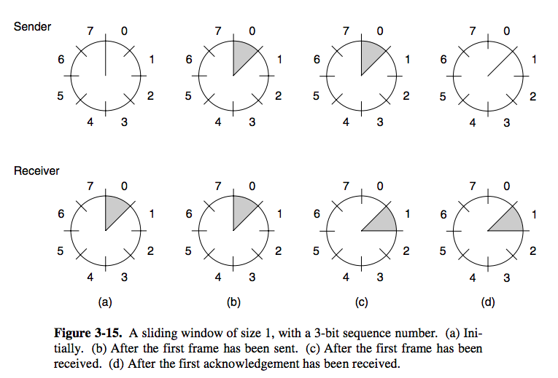
Sliding Window for a 3 bit Sequence Number
Source: Computer Networks (5th Edition) by Tanenbaum, Wetherell

Slide 40
Sliding Window Protocols in Noisy Channels
A timeout occurs if a segment (or the acknowledgment) gets lost
How does the flow and error control protocol handle a timeout? :
Go Back N ARQ: If segment N is lost, all the segments from segment 0 (start of the sliding window) to segment N are retransmitted
Selective Repeat (SR) ARQ: Only the lost packets are selectively retransmitted
Negative Acknowledgement (NAK) or Selective Acknowledgements (SACK): Informs the sender about which packets need to be re sent (not received by the receiver) . This takes place when an OUT-of-ORDER packet arrives instead of one which was expected. It is then stored in a buffer if it is in the Receiving Window and an NAK is sent for the frame which was expected. The Receiver holds the ACKs of the out-of-order packets till they are o-o-o because an ACK to any one of them would be treated as Cumulative ACK and the un received expected Packet would be deemed reached by the Sender and DATA LOSS / PACKET LOSS would happen.

Slide 41
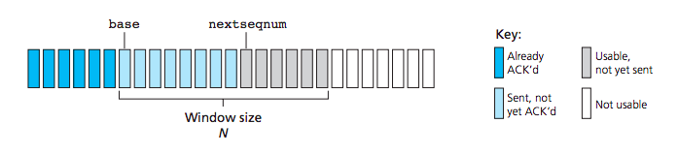
Go Back N ARQ – Sender Window Control
Base + N
Source: Computer Networks, Kurose, Ross

Slide 42
Go Back N ARQ
So over here we have a Sliding Window Size = 3. As soon as a packet is sent, a timer for it is initiated and started (!! Contrasting to the state transition Diagram ). So after the Frame 2 is sent => Sending Window is now full of Outstanding Frames. We are waiting for receiving an ACK
( ACK of Segment 0 in general, but Cumulative maybe anyone of the Outstanding Frames ) and stop sending further frames. We then receive the ACK 0 and then slide our window forward which then makes it possible to send Frame 3. After receiving ACK 1 and then Sending Frame 4 we have our Window Full Again and are awaiting an ACK again. However if this ACK 2 gets lost, we suffer a Timeout and then All the Frames in the Sending Window during the Timeout are Resent .
Source https://www.tutorialspoint.com/data_communication_computer_network/data_link_control_and_protocols.htm

Slide 43
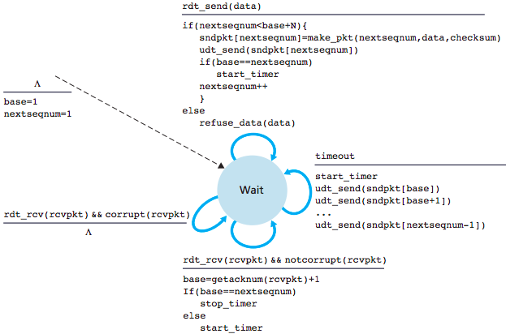
Go Back N ARQ – Sender
When base == nextseqnum => we have just sent the starting segment of the sliding window. So we would be awaiting its ACK before progressing forward with our sliding window.
Hence we start the timer awaiting the ACK of the just sent Segment, which is the starting one.
nextseqnum = base + N
When ++base == nextseqnum => we have just received the last sent segment’s ACK and hence there are NO OUTSTANDING segments in the Channel atm. Therefore we close the TIMER
In case not, this means we simply received the ACK for a segment for whom the timer was on, and now we restart the timer to track the next in line segment’s ACK, which has been sent just after the previous base
Kurose, Ross

Slide 44
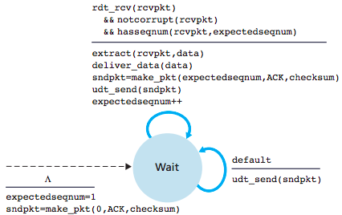
Go Back N ARQ – Receiver
By default, the Receiver keeps on sending the last sndpkt, demanding the packet it expects, if it doesn’t receive the expected packet
Source: Computer Networks, Kurose, Ross

Slide 45
Go Back N ARQ – A Bound on Window Size
Outstanding Frames – Frames that have been transmitted, but not yet acknowledged
Maximum Sequence Number (MAX_SEQ): MAX_SEQ+1 distinct sequence numbers are there
0,1,…,MAX_SEQ
Maximum Number of Outstanding Frames (=Window Size): MAX_SEQ
Example: Sequence Numbers (0,1,2,…,7) – 3 bit sequence numbers, number of outstanding frames = 7 (Not 8)

Slide 46
Go Back N ARQ – A Bound on Window Size
Let MAX_SEQ = 3, Window Size = 4
0
0
1
2
3
0
0
1
2
3
0
0
1
2
3
0
1
0
1
2
3
0
0
1
2
3
0
2
0
1
2
3
0
3
0
1
2
3
0
0
1
2
3
0
Timeout
0
1
2
3
0
0
0
1
2
3
0
The Sender sends a 0 and the Receiver receives a 0, the Receiver was also expecting a 0,
however of the next batch of SeqNum. This would lead to an error, because even though the sequence numbers match, the Packets Sent might not be compatible to one Expected

Slide 47
Go Back N ARQ – A Bound on Window Size
Let MAX_SEQ = 3, Window Size = 3
0
0
1
2
3
0
0
1
2
3
0
0
1
2
3
0
1
0
1
2
3
0
0
1
2
3
0
2
0
1
2
3
0
Timeout
0
0
1
2
3
0
0
1
2
3
0
Discards the wrong frame correctly

Slide 48
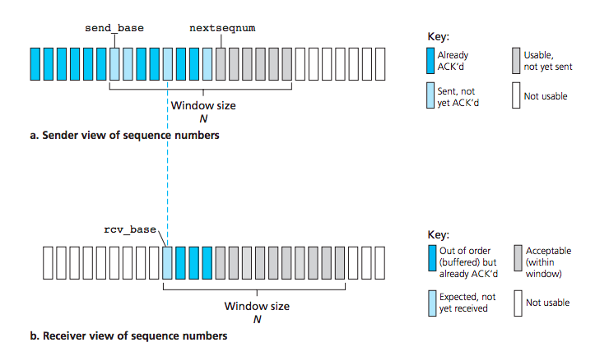
Selective Repeat (SR) – Window Control
Source: Computer Networks, Kurose, Ross

Slide 49
Selective Repeat ARQ
We have a Sliding Window Size : 2
We initially send Packet0 and Packet1 and then stop and wait for ACKs. Here an ACK2 acts cumulatively as ACK1 and ACK2 hence the Sliding Window shifts by 2 places. So even if ACK1 is not sent, or gets lost, if we receive ACK2 we’re good to go.
After which one Frame gets lost and the next Frame reaches it safely. This is now an OUT-of-ORDER packet as the Packet previous it which was expected was not received. This packet is then stored in a buffer if it is in the Receiving Window. ( if not its discarded by the receiver and an NAK for the expected packet ; 2 here is resent ) An NAK is sent for the frame which was expected. The Receiver holds the ACKs of the out-of-order packets till they are o-o-o because an ACK to any one of them would be treated as Cumulative ACK and the un received expected Packet would be deemed reached by the Sender and DATA LOSS / PACKET LOSS would happen.
Cumulative ACK works for <= all OUTSTANDING
ACK Loss => Cumulative ACKs take care of them, Frame Loss => NAKs
226 - Kurose Ross

Slide 50
Selective Repeat – A Bound on Window Size
Maximum Sequence Number (MAX_SEQ): MAX_SEQ+1 distinct sequence numbers are there
0,1,…,MAX_SEQ
Maximum Number of Outstanding Frames ( =Window Size ): (MAX_SEQ+1)/2
Example: Sequence Numbers (0,1,2,…,7) – 3 bit sequence numbers, number of outstanding frames (window size) = 4
In Case all the ACKs get lost, the Sender Side will undergo a TIMEOUT and will resend all the OUTSTANDING Frames again. However the Receiver will need to discard them as it has already received these packets. Now Since Out-of-Order packets are allowed in Selective Repeat we need to make sure that In such a Case when the Whole Batch of Frames is being resent, the SequenceNumber of NONE of them should be in the Receiving Window of the Receiver.
As after a Batch has been sent, the receiving side window shifts by W places. So there basically should not be any repeated SeqNum in this whole span of W + W. This means that 2*W <= (Number of SeqNum = MAX_SEQ+1) => W = 1<<(N-1)

Slide 51
Selective Repeat – A Bound on Window Size
Let MAX_SEQ = 3, Window Size = 3 [(MAX_SEQ+1)/2+1]
0
0
1
2
3
0
0
1
2
3
0
1
2
0
1
2
3
0
1
0
1
2
3
0
1
2
0
1
2
3
0
2
0
1
2
3
0
1
2
Timeout
0
0
1
2
3
0
0
1
2
3
0
1
2

Slide 52
Selective Repeat – A Bound on Window Size
Let MAX_SEQ = 3, Window Size = 2
0
1
2
3
0
0
0
1
2
3
0
1
2
0
0
1
2
3
0
1
0
1
2
3
0
1
2
Timeout
1
0
1
2
3
0
0
0
1
2
3
0
1
2
0
Discards the wrong frame correctly

Slide 53
Transport Layer Performances
Basically now we have a look into some features and factors which determine the kind of protocol and the corresponding parameters that we use.
So there are certain properties and features of a particular communication channel which govern our choice of the protocol we follow, the algorithm we adopt and the parameters we use.
An example is the Bandwidth Delay Product which loosely can be said to determine the Maximum Amount of Data that can be send through the channel in one Round Trip Time unit
Another one being the implementation of the transport layer buffer that each application holds Fixed Size Chain Buffers, Variable Size, Circular Buffers these choices determine the overheads and the optimality of utilization of memory in the systems
Our aim while choosing these features is the optimal utilization of the resources at our disposal with an effective tradeoff between overheads and performance.

Slide 54
Bandwidth Delay Product (see copy)
Bandwidth Delay Product (BDP) = Link Bandwidth x Link Delay – an important metric for flow control It helps us decide the Optimal Window Size we should choose so as to saturate the Link Utilization, and hence the number of bits we should reserve for our Sequence Numbers. Also at times the information we get from this can be used to choose which Flow Control Algorithm we should use: STOP and WAIT , GO BACK N , Selective REPEAT
Consider Bandwidth = 50 Kbps, one way transit time (delay) = 250 ms
BDP 12.5 Kbit
Assume 1000 bit segment size; BD = 12.5 segments
Consider the event of a segment transmission and the corresponding ACK reception – this takes a round trip time (RTT) – twice the one way latency. Here I guess we are ignoring a number of other factors like CONGESTION, other stray delays in the Network and we are considering that the propagation delay = end to end delay, so the RTT is considered to be equal to twice the latency.
Max no. of segments that can be outstanding during this duration = 2 x BD = 25
This can be thought of the number of segments in the two way pipe at any RTT duration

Slide 55
Bandwidth Delay Product – Implication on Window Size
Maximum number of segments that can be outstanding within this duration = 25 + 1 (as the ACK is sent only when the first segment is received) = 26
This gives the maximum link utilization – the link will always be busy in transmitting data segments
Let BD denotes the number of frames equivalent to the BDP, w is the maximum window size
So, w = 2BD + 1 gives the maximum link utilization – this is an important concept to decide the window size for a window based flow control mechanism
I guess the +1 here is for the one packet which will is being processed at one of the ends, and the remainder of them are in the channel moving from one end to the other

Slide 56
Implication of BDP on Protocol Design Choice
Consider the link bandwidth = 1Mbps, Delay = 1ms
Consider a network, where segment size is 1 KB (1024 bytes)
Which protocol is better for flow control?
(a) stop and wait,
(b) Go back N,
(c) Selective Repeat
BDP = 1 Mbps x 1ms = 1 Kb (1024 bits)
The segment size is eight times larger than the BDP -> the link can not hold an entire segment completely
Sliding window protocols do not improve performance
Stop and Wait is better – less complexity

Slide 57
Application - Transport Layer Interfacing – Sender Side
APPLICATION
This produces data at a rate say App_Data_Rate
These two rates are pretty much asynchronous in the sense they are independent of each other and hence there is a need to regulate this difference in order to prevent any data loss from taking place in case GENERATION RATE >>> SENDING RATE
USER
UNIQUE PORT
write(), send()
Trigger Periodically
Transmission Rate Control
The applications are connected to the kernel space at unique ports which are act as the headers or aliases to the application from within the kernel.
TportSend()
This module with the Flow Control Algorithms determines the optimal rate of TRIGGERS at which Segments should be sent to the layers beneath it especially the NETWORK LAYER for the udt_send()
KERNEL
Send Data to IP
Function names are hypothetical

Slide 58
Application Transport Interfacing – Sender Side
Different connections are treated differently, so we need connection specific source buffering
APPLICATION
USER
Basically this means that each Application must have a separate dedicated buffer for it, since how the buffer is used varies from application to application. So each Port has its own Associated Buffer
write(), send()
Trigger Periodically
Transmission Rate Control
KERNEL
If the buffer gets full, the write() will block the port
TportSend()
This comes into play when the Application generates data at a rate greater than the Transmission Rate.
write() call blocks the port until the complete data is written in the transport buffer
Transport Buffer - Sender
Send Data to IP
Function names are hypothetical

Slide 59
Application Transport Interfacing – Receiver Side
APPLICATION
read() call blocks the port until the data is received and the complete data is read from the transport buffer
USER
read(), recv()
Function names are hypothetical
As we know different applications have different buffers, this layer determines the correct application’s buffer to be used from the HEADER’s Port No. Field and selects the correct Buffer to write the data into
KERNEL
Interrupt
Interrupt : Mechanism of interaction with buffer
generated when there is data to read in the buffer
Buffer is one-one with Ports
Read(), Recv()
wait on this if the
CheckBuffer()
TportRecv()
buffer is empty when the call was made
Data from IP
Transport Buffer - Receiver

Slide 60
Application Transport Interfacing – Receiver Side (Alternate Implementation)
APPLICATION
USER
read(), recv()
Function names are hypothetical
KERNEL
get()
poll()
PollBuffer()
TportRecv()
Data from IP
Transport Buffer - Receiver

Slide 61
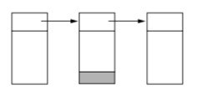
Organizing Transport Buffer Pool for each application
If most segments are nearly the same size, organize the buffer as a pool of identically sized buffers (one segment per buffer)
For variable segment size – chained fixed sized buffer (buffer size = maximum segment size)
Space would be wasted if segment sizes are widely varied
Small buffer size – multiple buffers to store a single segment – added complexity in implementation

Slide 62
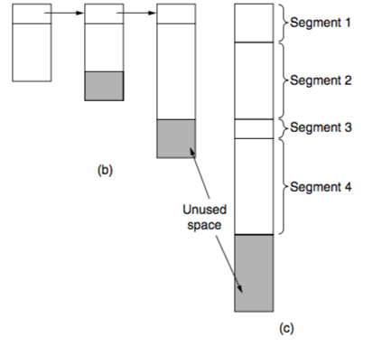
Organizing Transport Buffer Pool
Variable size buffers (b)
Advantage: better memory utilization
Disadvantage: Complicated implementation
For each segment to be attached we would need to dynamically allocate some memory and then append it to the current buffer and then add the data
Single large circular buffer for every connection (c)
Good use of memory only when connections are heavily loaded
This is because this is after all a Fixed Sized buffer , so in case not much data is there to be stored, i.e. the load on the buffer is not too much, we would again be wasting a lot of statically allocated space.
Computer Networks (5th Edition) by Tanenbaum, Wetherell

Slide 63
Dynamic Buffer Management for Window Based Flow Control
Sender and receiver needs to dynamically adjust buffer allocations
On the Receiver Side ; based on the rate difference between the receive rate by the transport entity and the receive rate by the application, the available size of the receiver buffer changes
Sender should not send more data compared to receiver buffer space – dynamically adjust window size based on availability of receiver buffer space
Segments awaiting at the buffer
Segments read by the application
Free Space at Receiver Buffer

Slide 64
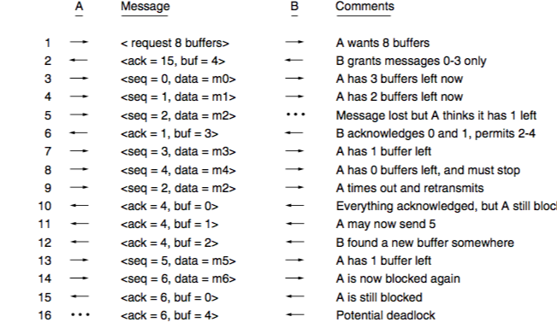
Dynamic Buffer Management for Selective Repeat
Here A initially requests for a buffer (window size ) of 8 but B in its ACK only allows 4. A sends 0 , A sends 1 , A sends 2 ( lost)
B sends an ACK for 1( and 0 ) and allots a buffer of 3 now.
This 3 will permit 2-4 since B hasn’t recv 2.
A sends 3, A sends 4 and then waits for ACK
B has stored 3 and 4 in its buffer while waiting for 2. No NAK has been sent, so A times out and resends 2-4 which is then ACKed by B with a buffer of 0 -> Blocking A Another ACK sent with same ACK value and buffer of 1 allowing 5 to be sent. Another ACK sent now with buffer of 2 allowing 6too
A sends 5, A sends 6 and then waits for ACK
B ACKes the sends with a buffer of 0.
B now sends another ACK with buffer of 4
WHICH GETS LOST AND NO REACHES A
B keeps on waiting for A (blocked) to send
SENDER
RECEIVER
In order to take care of this deadlock, we need to have B handle this deadlock If B does not receive any data from A and the connection is still open, it times-out and sends the previous ACK till the deadlock is resolved.

Slide 65
Congestion Control in the Network
Consider a centralized network scenario – how can you maintain optimal flow rates?
A network can be visualized as a graph with nodes being the intermediate routers/ end-systems and the edges being the limits on the BDP of the link, or the Max Rate it can transmit data at etc.
The Choice of the optimal flow rate between a Source and a Sink can be computed using the Max-Flow Min-Cut. However, this aint practically
Possible.
6
S
D
50
5
18
10
50
2
2
20
11
4
Congestion occurs when I push data more than the bottleneck capacity of the network. Whenever this happens the corresponding application buffer at intermediate nodes start getting filled up and eventually may overflow and a packet loss / drop might occur.
Also when there are multiple Source-Sink pairs in the same network, no Algorithm can figure out the Optimal Rate. Moreover since the centralized information about the whole networks is not available at the individual routers or in fact even the end-hosts in case it is a distributed network, hence it is tough to implement algorithms for Congestion Control which take into account the whole network’s properties in order to come up with some Optimal Flow Allowances for each Link.

Slide 66
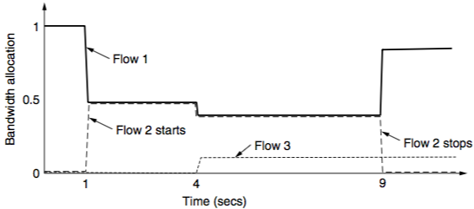
Congestion Control in the Network
Here we depict the Dynamically changing Allocation of Bandwidth
to different flows as more and more flows come and go out of the network with time.
Lets say the Bottleneck Capacity of the Network = 1MBps.
Initially all of this is allocated to a Flow1 which has a reqt >= 1MBps
After this another Flow2 with similar requirements starts competing with Flow1 for Bandwidth and the network FAIRLY allocates both the Flows a Bandwidth of 500KBps.
Changing Bandwidth Allocation over Time
Next a Flow3 with reqt = 100KBps starts. Since it also needs to be catered to, the network allocates it 100KBps and divides the remaining 900KBps amongst Flow1 and Flow2 as 450KBps a piece.
Computer Networks (5th Edition) by Tanenbaum, Wetherell

Slide 67
Congestion Control in the Network
Flows enter and exit network dynamically – so applying an algorithm for congestion control is difficult , as there is no a-priori knowledge about the kinds of flow one might encounter as time progresses.
Congestion avoidance: This entails detecting congestion in the network, and then tackling it by some modifications Regulate the sending rate based on what the network can support
Congestion CONTROL
Flow CONTROL
Sending Rate = minimum (network rate, Receiver rate)
Comes from flow control – receiver advertised window size for a sliding window flow control
This can be thought of as the dynamically changing max capacity which the network can support at any time. There is no method for its estimation, so this is implemented more in the form of a concept than any other thing.
What we do is we keep on increasing our “Network Rate” ( ki Sending ?? ) and observe the effect it has on the Flow Rates (specifically on Packet Loss ). If we assume that CHANNEL ERROR is very less, then any observable Packet Loss can be attributed to Excessive Queuing Delay at the intermediate routers which indicates that the inflow at a ROUTER is greater than the outflow which tells us that our sending rate has exceeded the network rate and hence needs to be brought down and controlled.

Slide 68
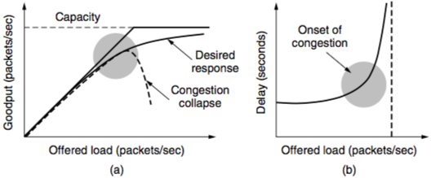
Network Congestion – Impact over Goodput and Delay
As soon as we encounter congestion in the network, there is a steady decrease in the GoodPut of our network. Packet Loss might happen and in that case, the Flow Control Algorithm will try to resend those packets and this would lead to the decrease in the GoodPut of the Network
This is because even though the sender is rapidly transmitting packets, effectively the amount of useful work that is being done is vey less since it is simply sending out duplicates which will be rejected by the receiver side.
Congestion also has a significant effect on the end to end delay between Packet Transmission Start and ACK reception. This can be attributed to the fact that retransmission of packet lost might again fall into congestion, or the buffer is still full so the packet will be lost again. Kind of a cascading of Packet Losses => exponential increase in the end-to-end delay.
Should allocate the Network Bandwidth up until the delay starts rising up rapidly. Max Power Case
Computer Networks (5th Edition) by Tanenbaum, Wetherell Page 531

Slide 69
Congestion Control and Fairness
Ensure that the rate of all the flows in the network is controlled in a fair way
Bad congestion control algorithm may affect fairness - Some flows can get starved
Some flows might be given priority over other flows and this would lead to a possible starvation in certain flows because the bandWidth allocated to them for their purposes will remain negligible.
Hard fairness: in a decentralized network is difficult to implement
Max-Min Fairness: An allocation is max-min fair if the bandwidth given to one flow cannot be increased without decreasing the bandwidth given to another flow with an allocation.

Slide 70
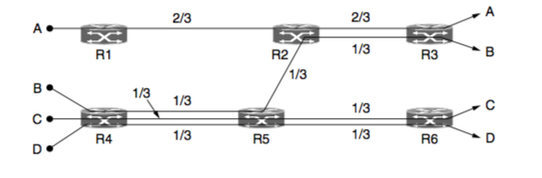
Max-Min Fairness – An Example
Even though A does not really use / saturate this particular LINK, its Bandwidth cannot be increased independently , without decreasing some other flows
An increase in A => Decrease in B
Since this link is saturated
Bottle Neck
Similarly B’s rate can not be increased without decrease in the rates of A and, C and D.
Even though C and D do not really use / saturate this particular LINK, their rates cannot be increased independently , without decreasing some other flow. Here B
Also to ensure fairness, if the requirements of C and D are the same, since the ROUTE they take is the same, we always have to allocated C and D the same Bandwidth
No Flow Rate can be changed independently without a corresponding decrease in some other Flow as well
Hence, this is a Max-Min Fair Network
Computer Networks (5th Edition) by Tanenbaum, Wetherell

Slide 71
AIMD – Efficient and Fair Operating Point for Congestion Control
Read from Tanenbaum, Page 538
Additive Increase Multiplicative Decrease (AIMD) – Chiu and Jain (1989)
Let w(t) be the sending rate. a (a > 0) is the additive increase factor, and b (0<b<1) is the multiplicative decrease factor

Slide 72
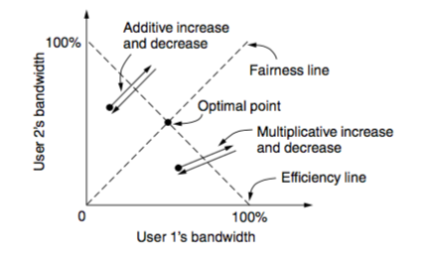
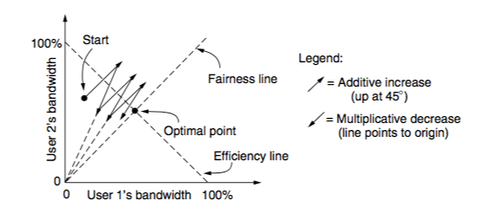
AIMD – Design Rationale (Two Flows Example)
AIAD – Oscillate across the efficiency line
MIMD – Oscillate across the efficiency line (different slope from AIAD)
Computer Networks (5th Edition) by Tanenbaum, Wetherell

Slide 73
AIMD – Design Rationale (Two Flows Example)
The path converges towards the optimal point
Used by TCP - Adjust the size of the sliding window to control the rates
Computer Networks (5th Edition) by Tanenbaum, Wetherell

Slide 74
Let us look TCP design details …

